Slide 1
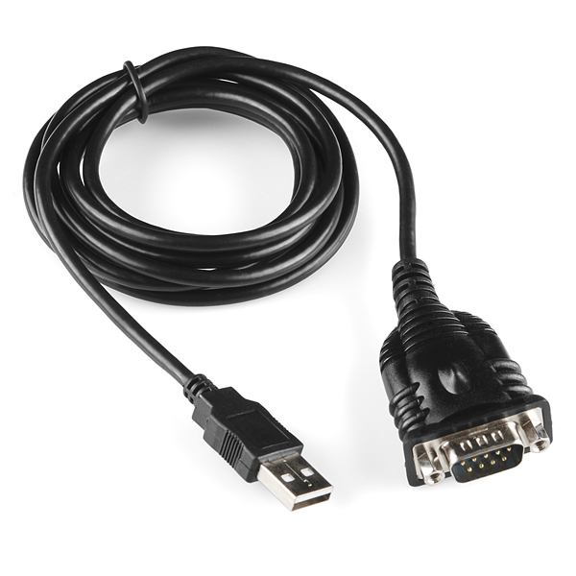
RS-232 to USB Convertor Working mechanism
Bipin Devkota
Apekshya Shakya
Maheswor Mahato
Raju Gupta

Slide 2
OVERVIEW
Introduction
What is RS-232?
Insight on USB interface
RS-232 VS USB interface
Connection of DTE and DCE through RS-232C Interface
Working Mechanism
Practical applications
Conclusion

Slide 3
Introduction
Have you ever wondered how your printer or keyboard connects to your computer? Well, it's all thanks to a little thing called RS-232.
RS-232 is a communication protocol that has been around for decades and has been used to connect various devices to computers.
However, with the advancement of technology, modern computers no longer have RS-232 ports. This is where the RS-232 to USB converter comes into play.
It allows us to connect our old devices to our modern computers and continue using them. So, let's dive into this intriguing technology and explore its importance in modern times.

Slide 4
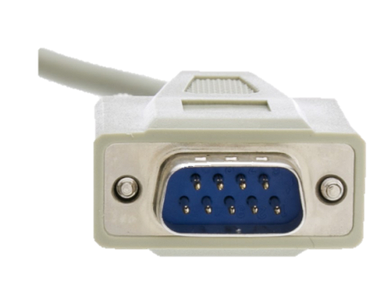
What is RS-232?
RS-232, also known as Recommended Standard 232, is a standard interface used in serial communication between computers and other devices.
It was first introduced in 1962 by the Electronic Industries Association (EIA) as a way to standardize the communication protocol between data terminal equipment (DTE) and data communication equipment (DCE).
Features:
It uses 25 pins standard.
It specifies that DTE connector should be male and DCE connector should be female
It sends 20KBd for distance of 50 ft
The voltage levels for RS-232 are:
Logic high: -3v to -15 v
Logic low: +3v to +15v

Slide 5
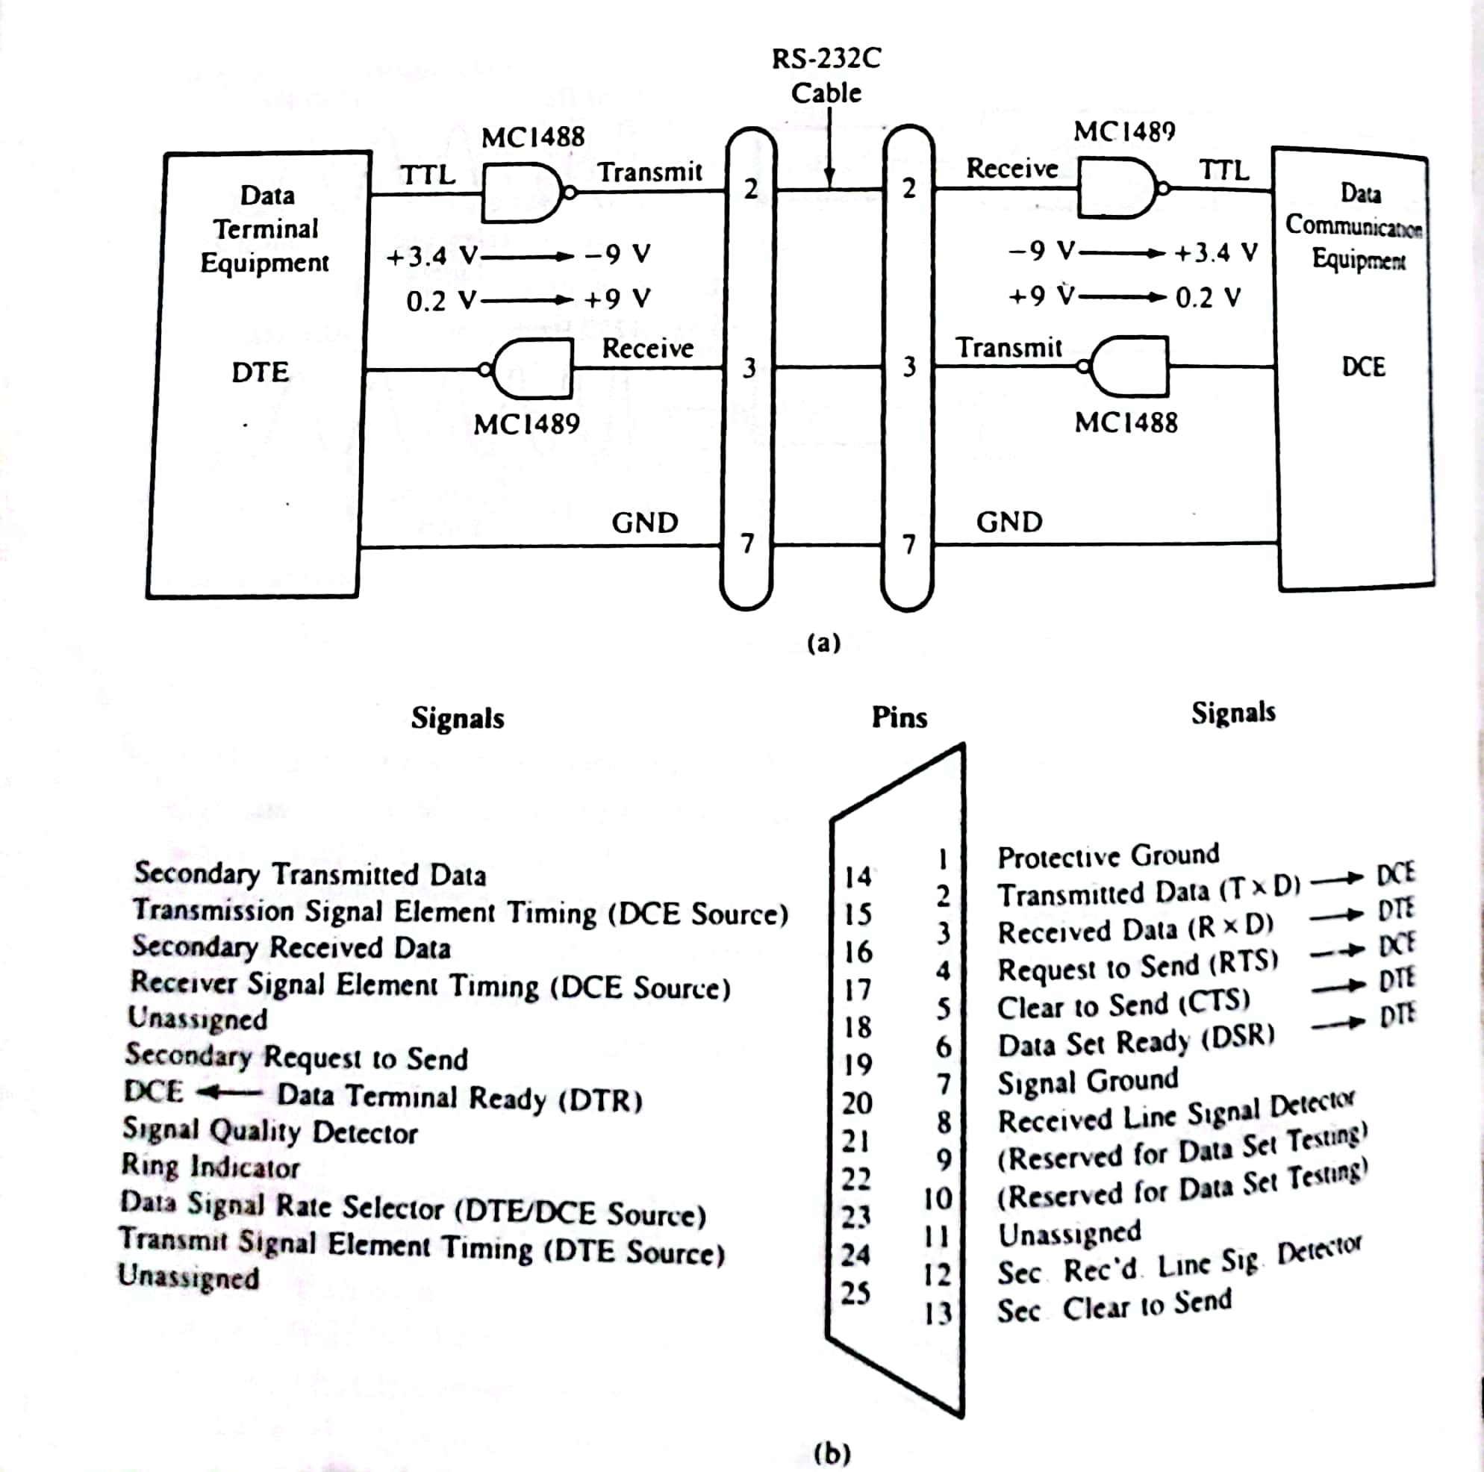
Connection of DTE and DCE through RS-232C Interface

Slide 6
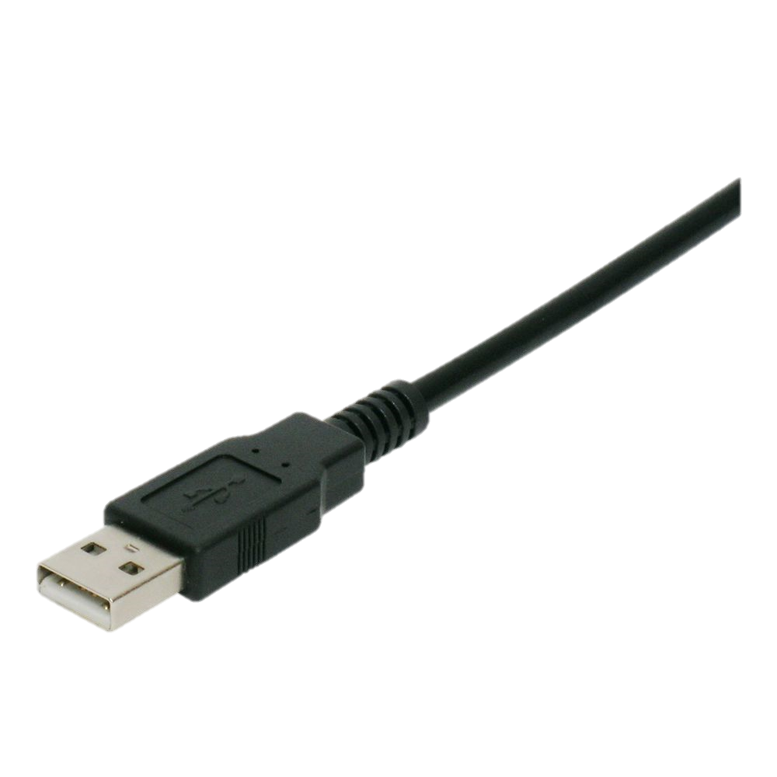
INSIGHT ON USB INTERFACE
Advantages :higher data rates, versatility and ease of use
Types of USB connectors : USB-A, USB-B, USB-C.

Slide 7
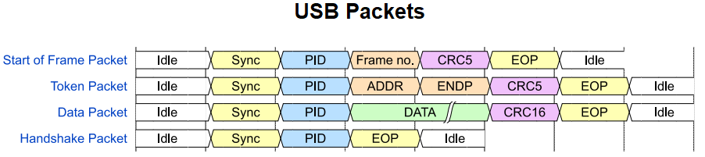
USB COMMUNICATION
USB packet structure: start of frame, data packets, end packets
USB data transfer modes: control, bulk, interrupt, isochronous
USB packet structure: start of frame, data packets, end packets
USB data transfer modes: control, bulk, interrupt, isochronous

Slide 8
RS-232 VS USB interface
RS-232
USB interface
Limited data rate .i.e. 20 Kbaud
Signal degradation
Lack of error correction
Bulky connectors
Higher data transfer rates 1.5mbps to 10 gbps
Extended cable lengths with no significant signal degradation
Error correction
Compact connectors
Notes:
Voltage Level Shifting:
RS-232 devices use higher voltage levels (typically ±3V to ±25V) for signaling, while USB devices use lower voltage levels (0V to 5V).
Converters include voltage level shifting circuitry to adapt RS-232 voltage levels to the USB-compatible range.
Signal Conversion:
RS-232 uses bipolar voltage signaling, where positive and negative voltage levels represent binary states.
USB uses differential signaling with D+ and D- wires that transition between positive and negative voltages.
Converter electronics convert RS-232 bipolar signals into USB's differential signals, ensuring accurate data transmission.
Data Formatting Translation:
RS-232 and USB employ different data formatting methods. RS-232 uses start and stop bits, parity bits, and control signals.
USB uses packet-based transmission with synchronization patterns and endpoints.
Converters translate data between these formats to ensure seamless communication between RS-232 device and USB host.
Flow Control and Handshaking:
RS-232 devices often use handshaking signals like RTS (Request to Send) and CTS (Clear to Send) for flow control.
USB utilizes its own flow control mechanisms based on acknowledgments and timeouts.
Converters manage translation of flow control signals, ensuring regulated, reliable data flow.
Driver Software:
USB devices require driver software to communicate with an operating system.
Some RS-232 to USB converters have integrated drivers; others use computer's native USB drivers.
Driver software allows computer to recognize converter as virtual COM port, enabling legacy RS-232 software to interface with USB device.
Speed and Throughput Management:
USB provides higher data transfer rates than RS-232. Converter adjusts data transfer rates between standards to ensure appropriate speed.
Converter manages any data rate and timing differences to prevent data loss or corruption.
Physical Connector and Enclosure:
Converter physically connects RS-232 device's connector to USB port on computer or device.
Enclosure houses electronics for signal conversion, voltage level shifting, and data formatting transl

Slide 9
Working Mechanism
Voltage level shifting
Signal conversion
USB communication

Slide 10
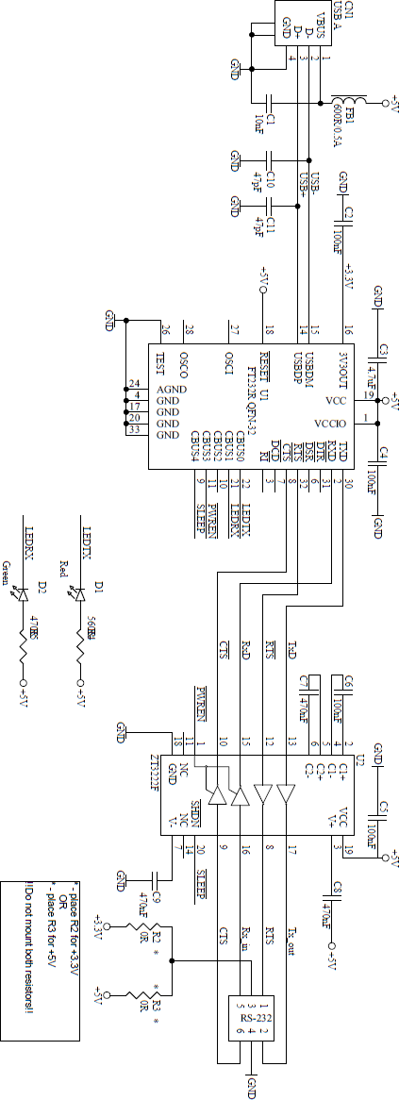

Slide 11
VOLTAGE LEVEL SHIFTING
Voltage levels are translated between RS-232 and USB RS-232 higher voltage levels (±3V to ±15V) vs. USB lower voltage levels (0V to 5V)

Slide 12
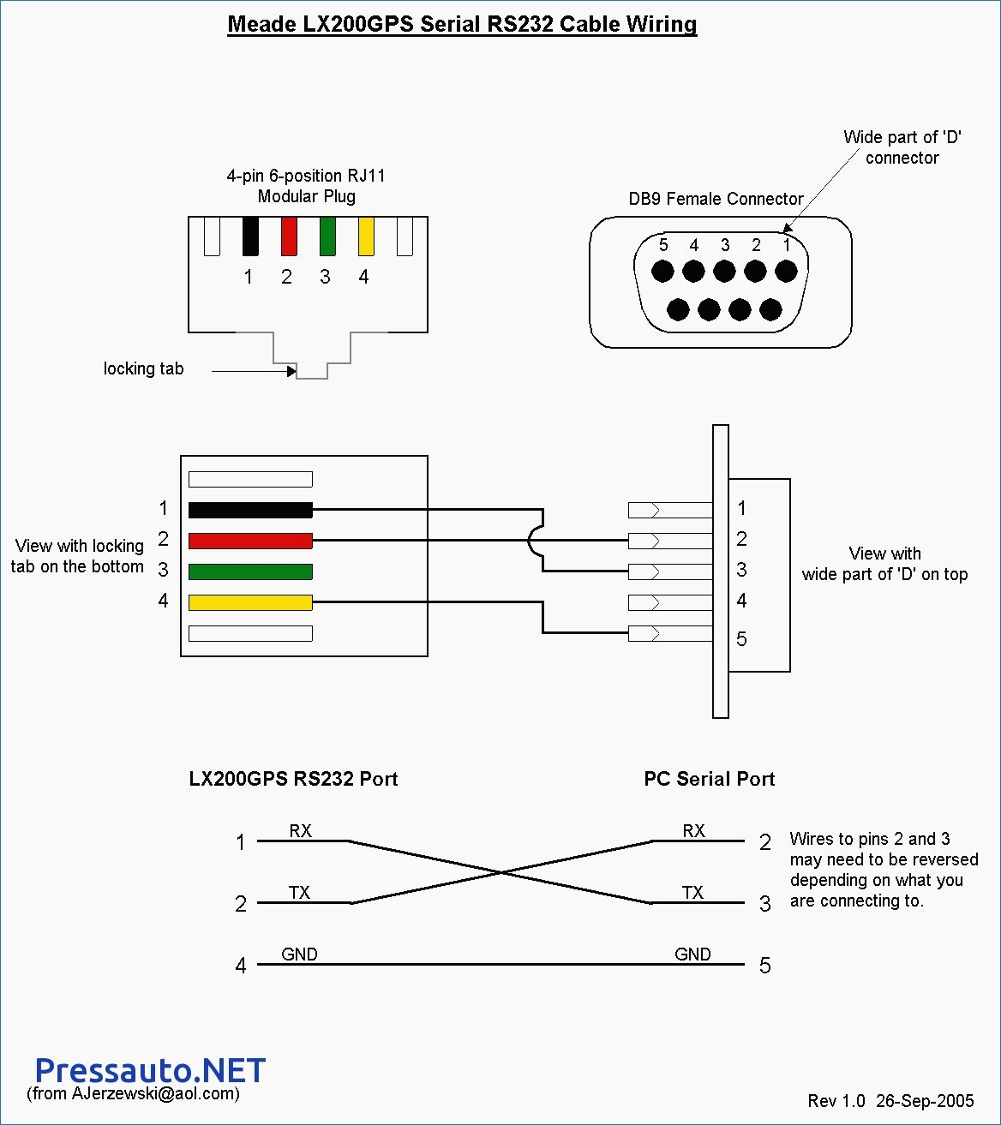
SIGNAL CONVERSION
RS-232 bipolar signaling is converted to USB differential signaling
RS-232 positive and negative voltage levels vs. USB D+ and D- Role of integrated electronics in signal conversion
UART : converts parallel data from RS-232 to serial data for USB transmission

Slide 13
PRACTICAL APPLICATION
Connecting legacy equipment (printers, modems, etc.) to modern computers
Industrial and automation applications

Slide 14
Conclusion
In conclusion, RS-232 to USB converter allows us to connect the legacy devices to our modern equipment and continue using them.

